Slide 1

Moodle Student Training
Login & Dashboard

Slide 2
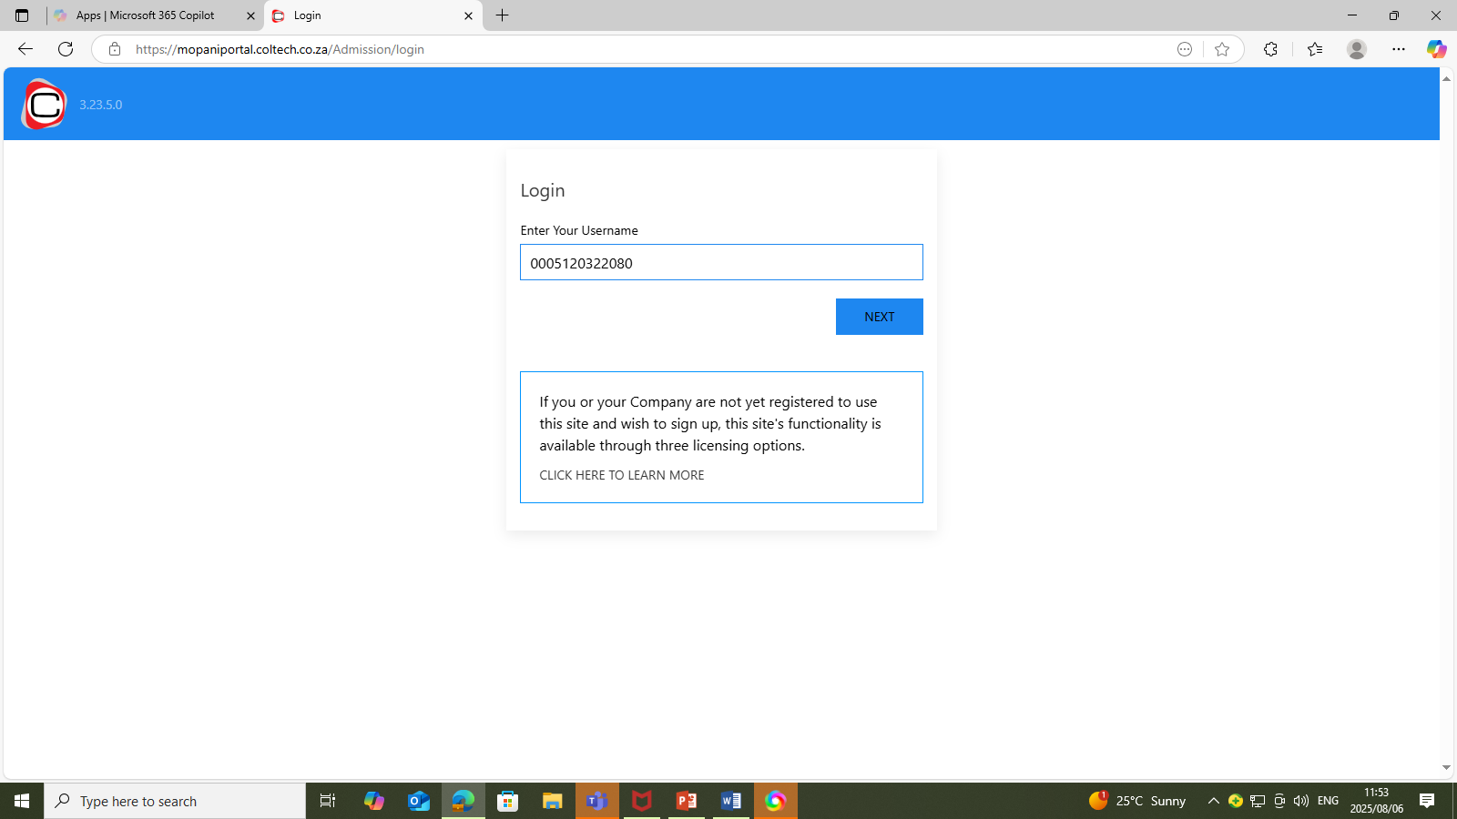
LOG IN TO MOODLE

Slide 3
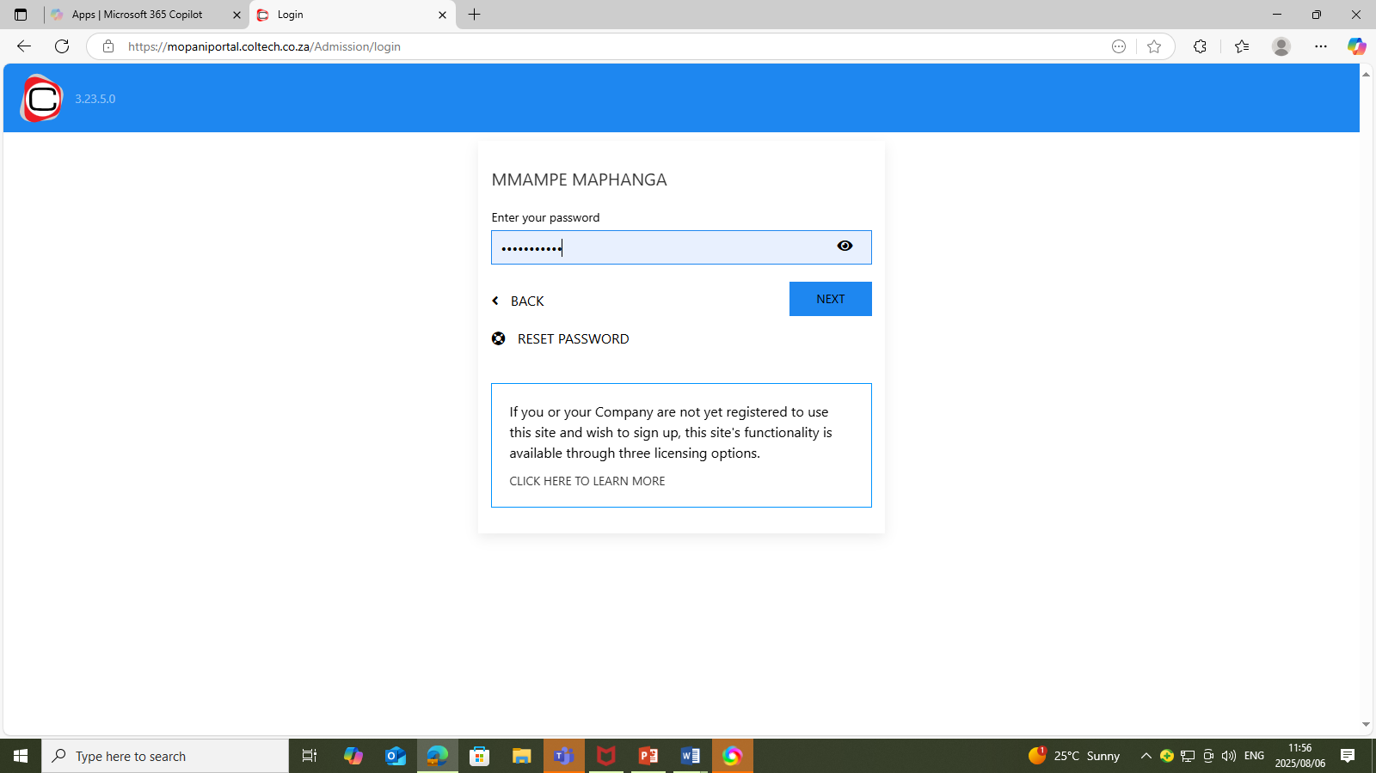
TYPE PASSWORD

Slide 4
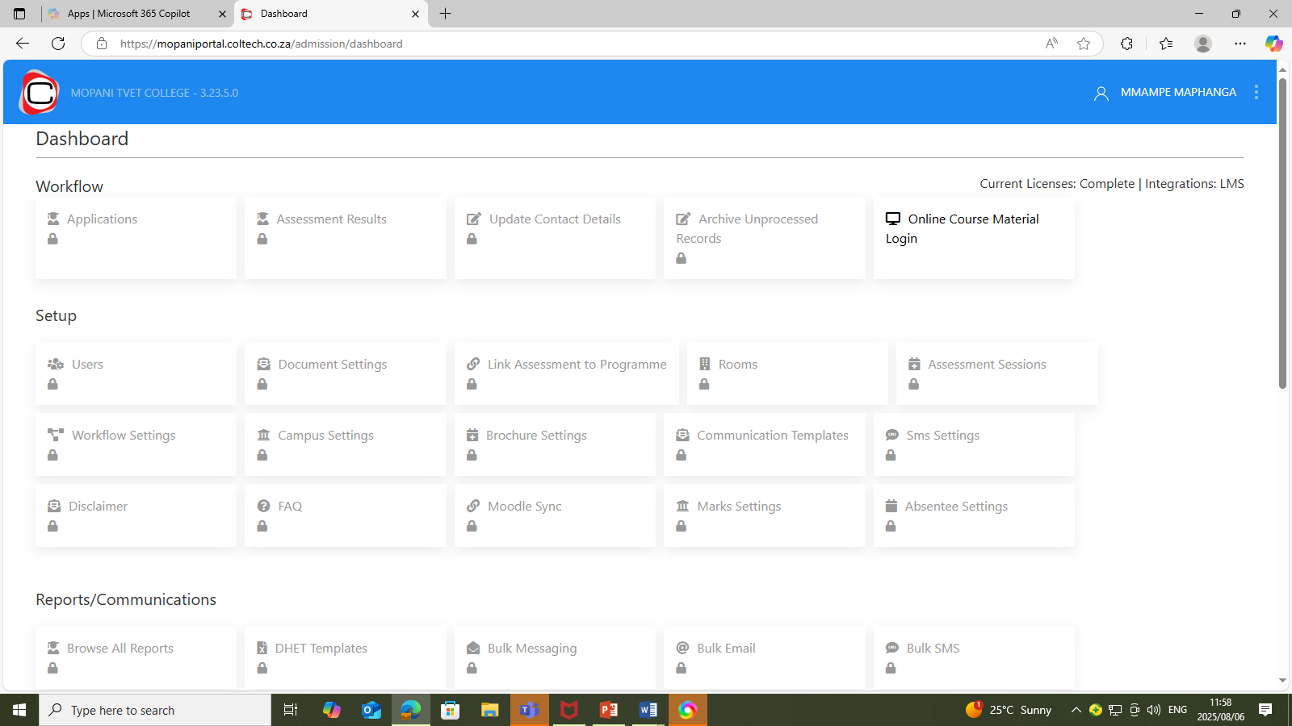
NAVIGATE TO COURSE MATERIAL

Slide 5
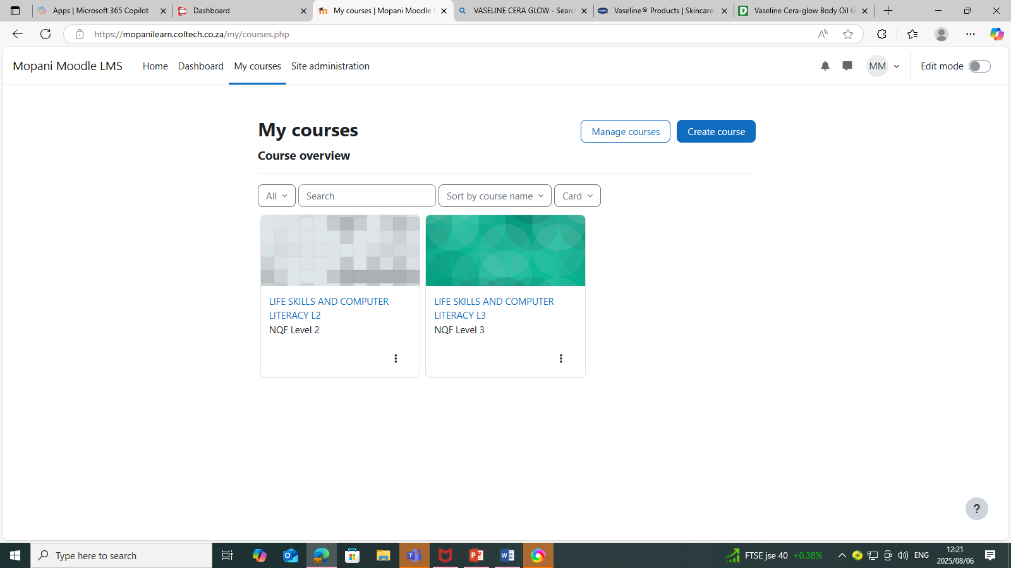
MY COURSES

Slide 6
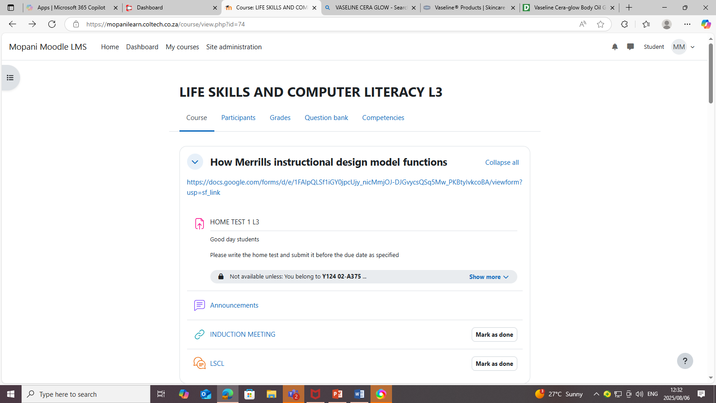
INSIDE YOUR COURSE
LINKS
TESTS & ASSIGNMEMTS

Slide 7
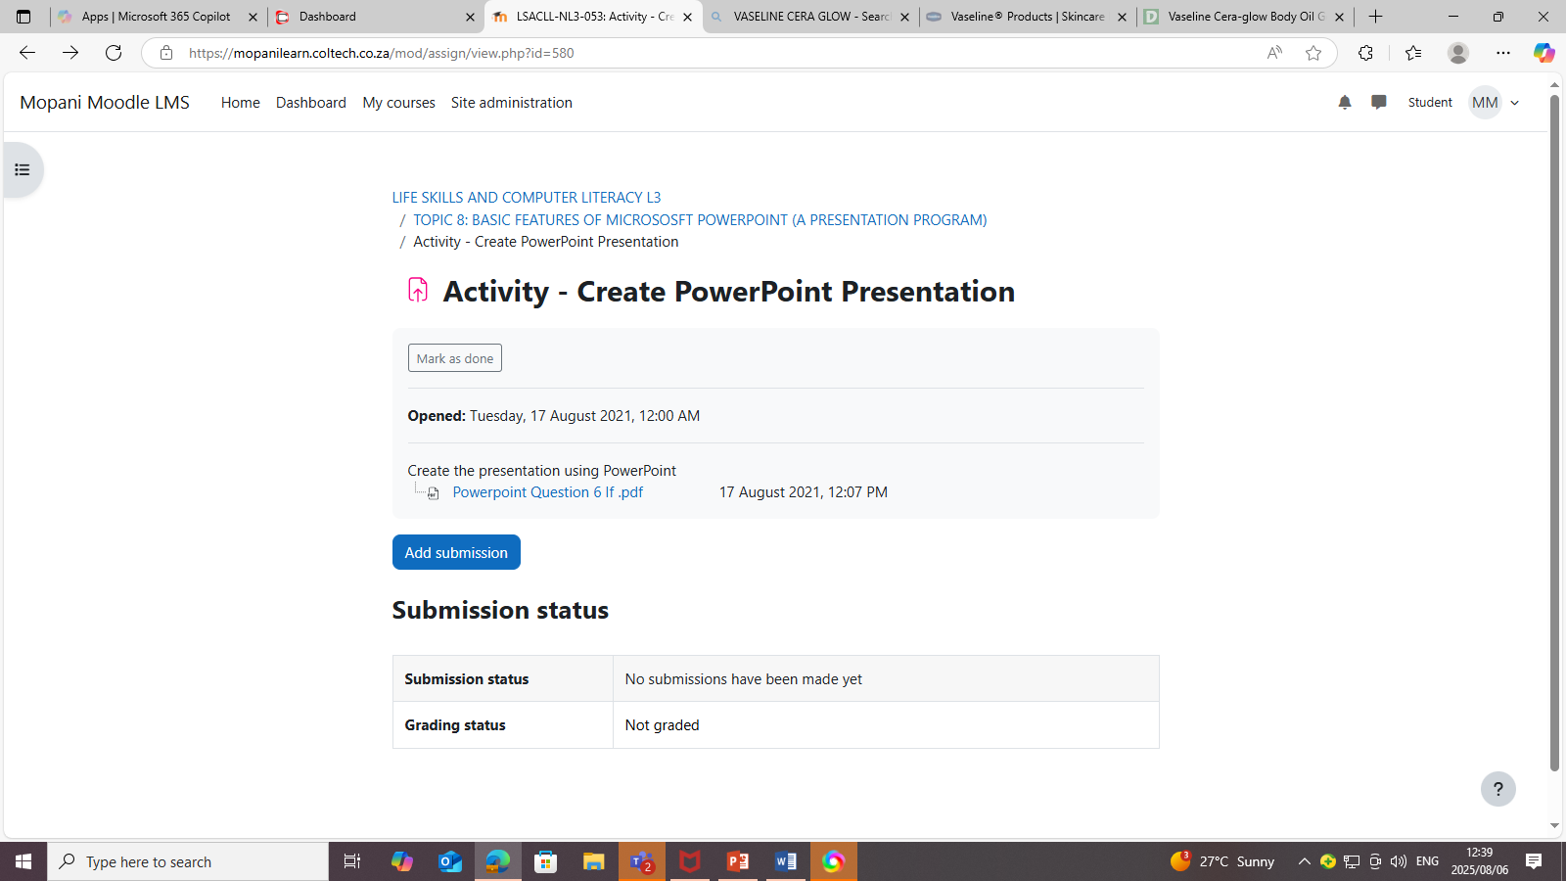
SUBMIT AND ASSIGNMENT

Slide 8
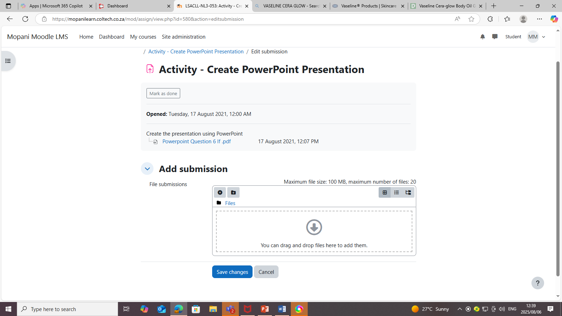
CLICK ON + TO ADD YOUR FILE(ASSIGNMENT)

Slide 9
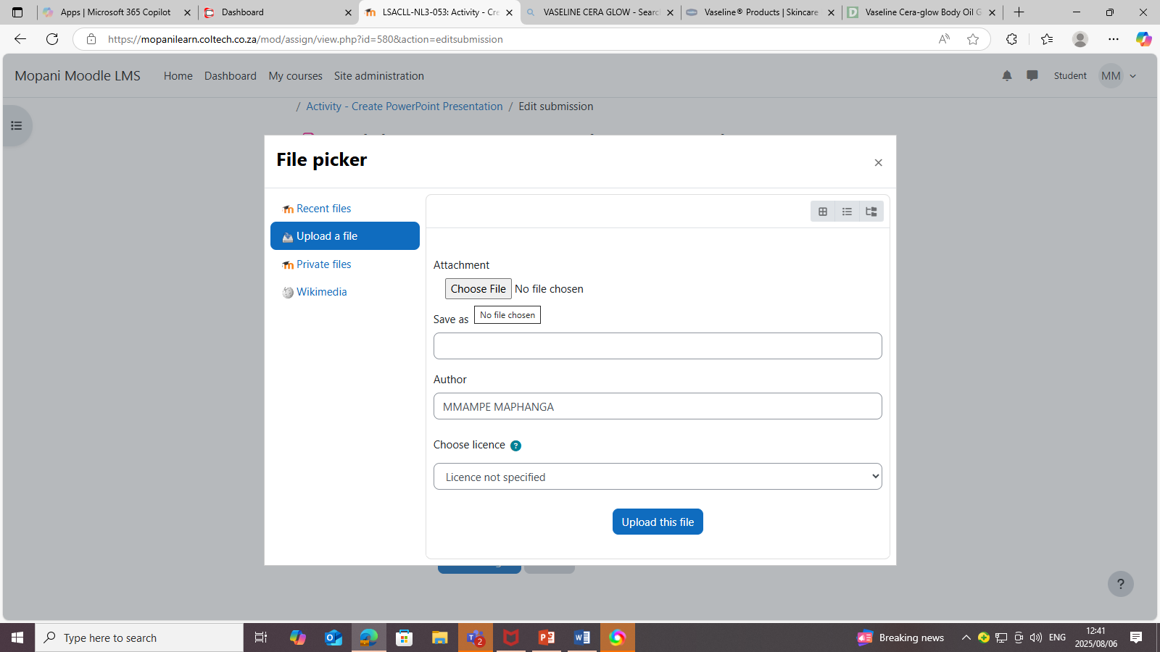
CLICK ON “CHOOSE FILE”

Slide 10
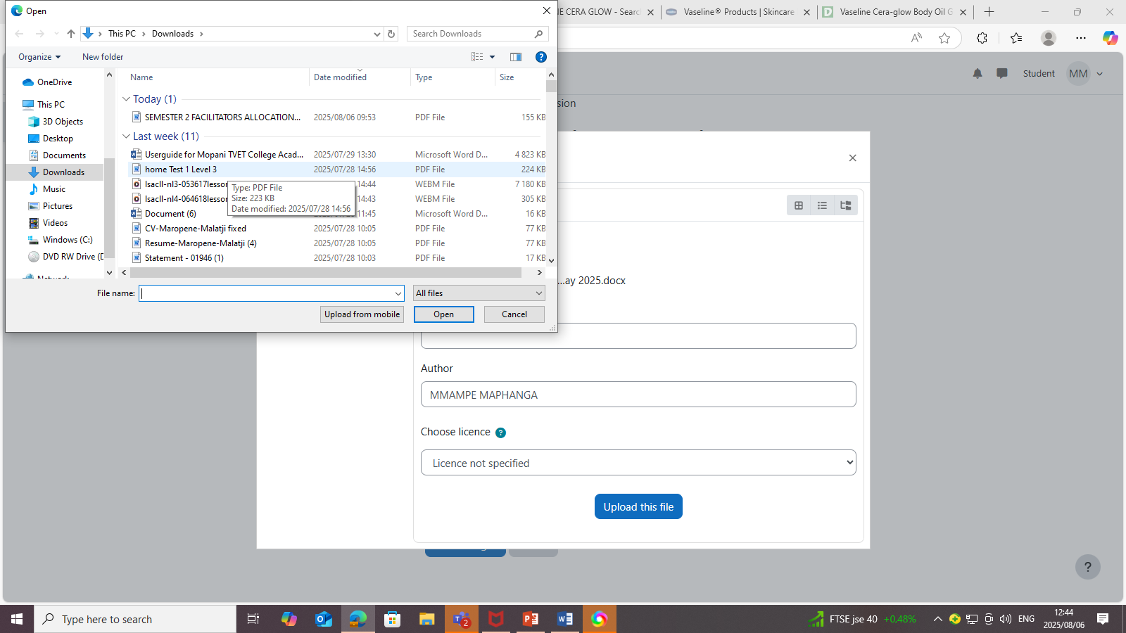
CHOOSE FILE

Slide 11

UPLOAD FILE

Slide 12
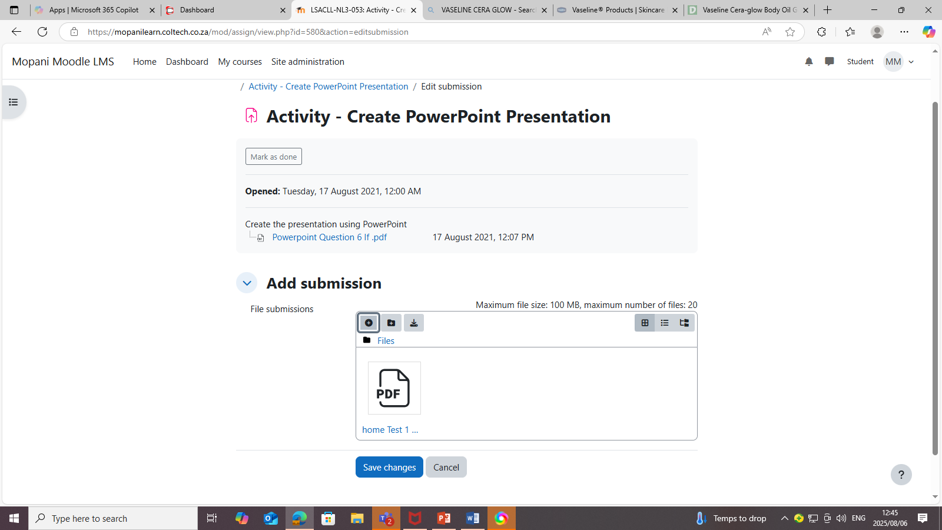
SAVE CHANGES

Slide 13
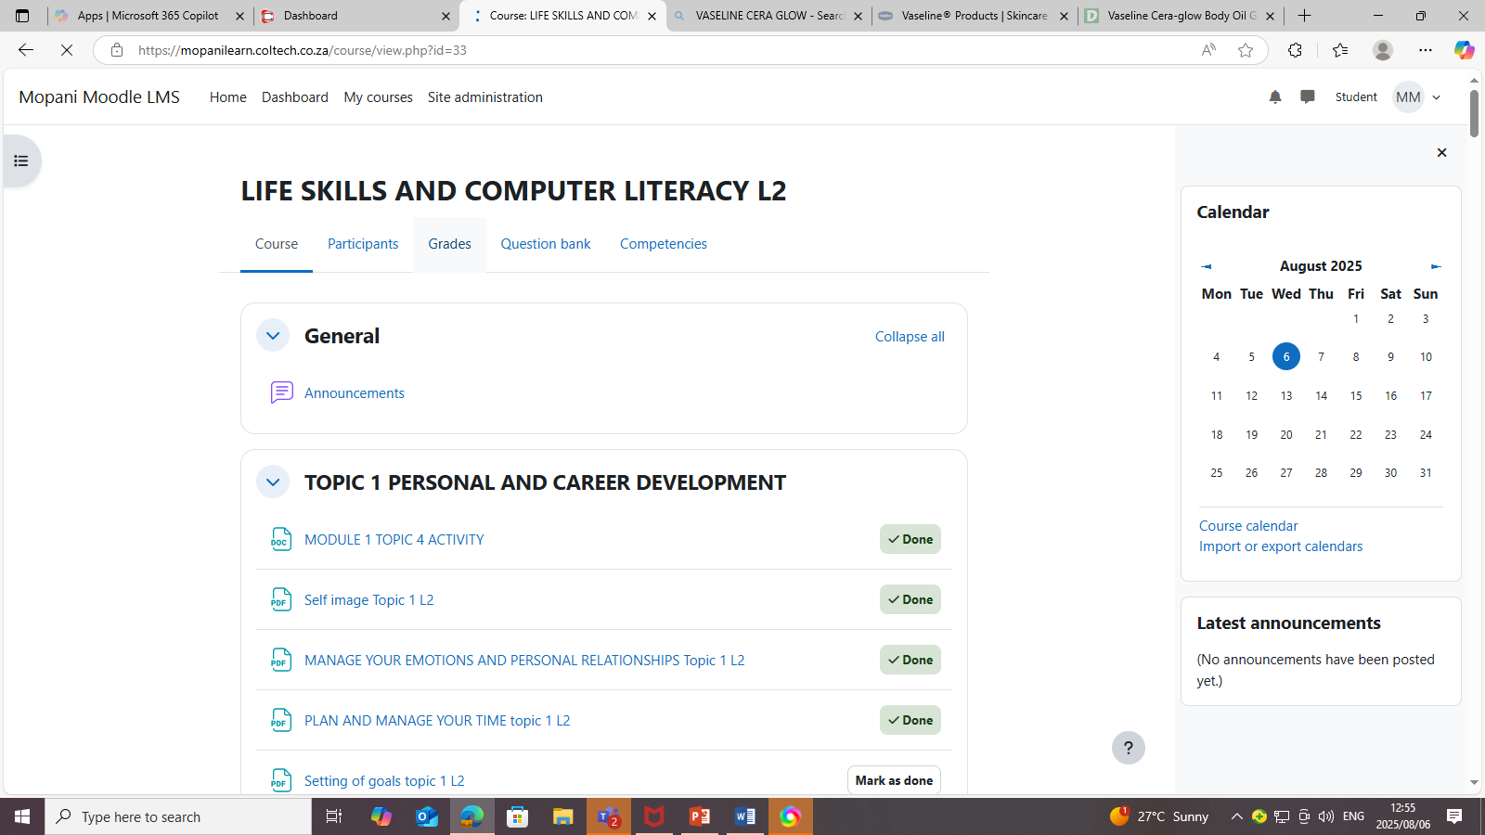
CHECK YOUR GRADES

Slide 14
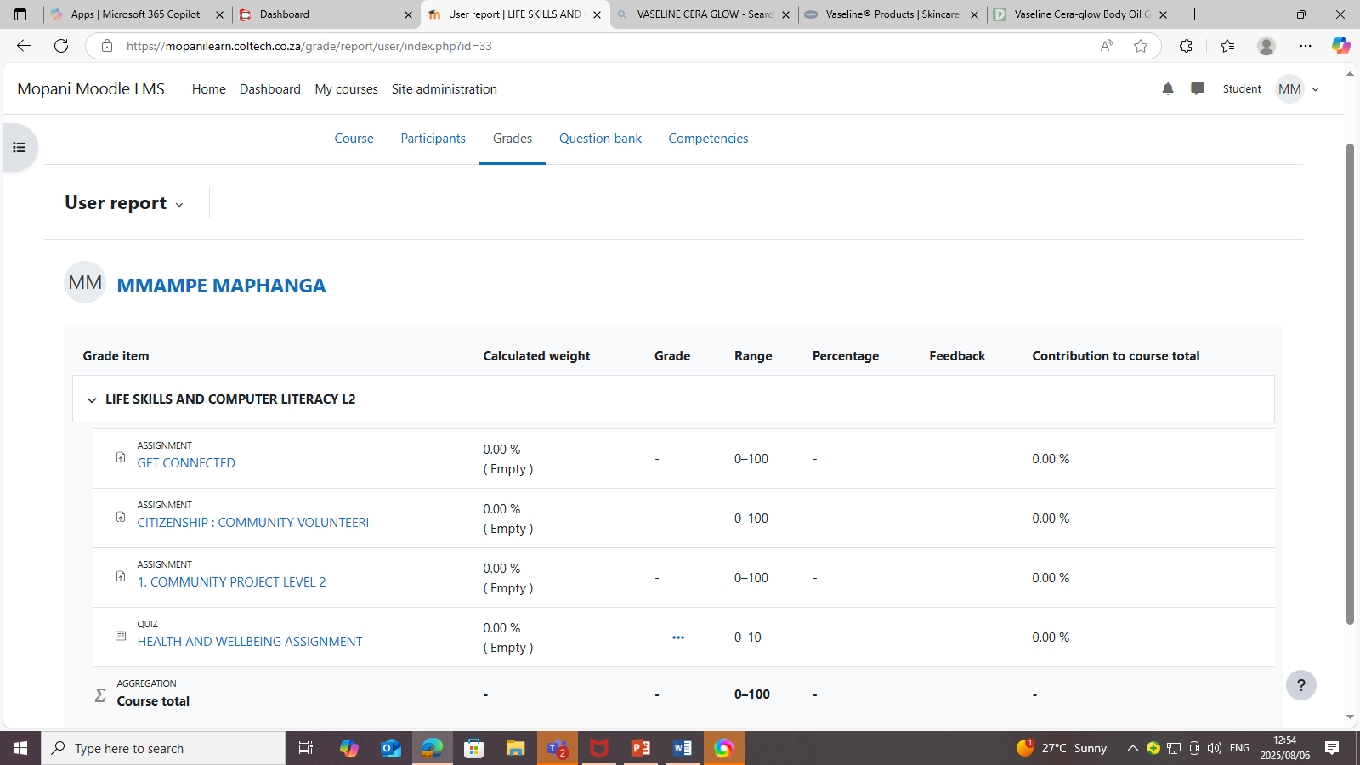
CHECK YOUR MARKS/GRADES

